Slide 1
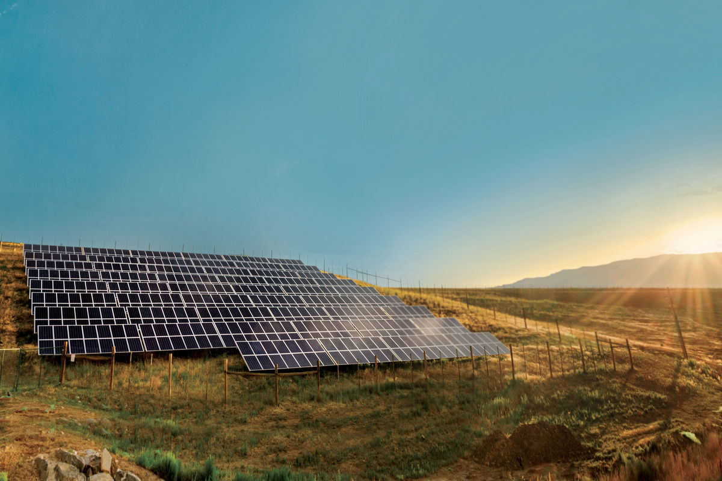


REPOWERING Australia
Notes:
Slide 1: TITLE SLIDE
Thank you for having me, its great to be here with _________ to talk about Repowering Australia with clean energy.

Slide 2
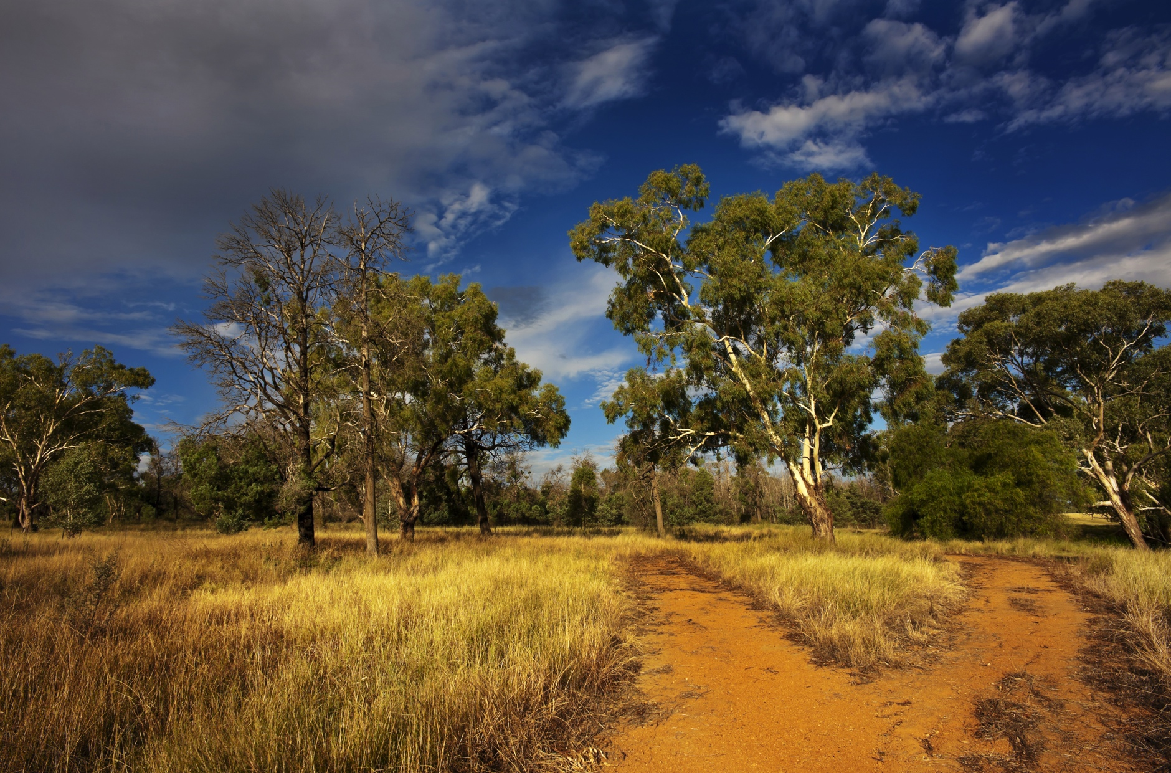
Our choice
Notes:
Slide 2: AUSTRALIA IS AT A CROSSROADS
Australia is standing at a crossroads. We have a choice about our energy future. However, that choice is no longer a choice between dirty energy and clean energy, it is not a matter of if, it's a choice about HOW we transition to clean energy.
Will the transition be slow, bumpy and leave people behind? Or will it be quick, efficient and inclusive?
Because the transition to clean energy is now inevitable.

Slide 3
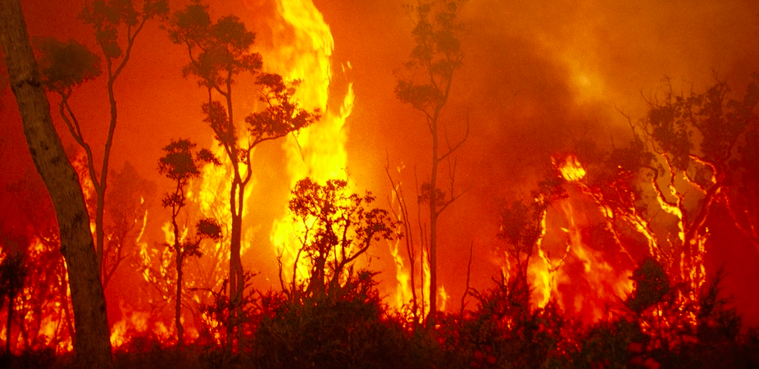

Our role
Faster
and
Fairer
Notes:
Slide 3: OUR ROLE
What is not inevitable is that this transition will be as fast as the climate science demands and as fairly as we should all demand.
This then is our challenge – driving a faster and fairer transition to clean energy.
The transition is now inevitable for 5 reasons.

Slide 4

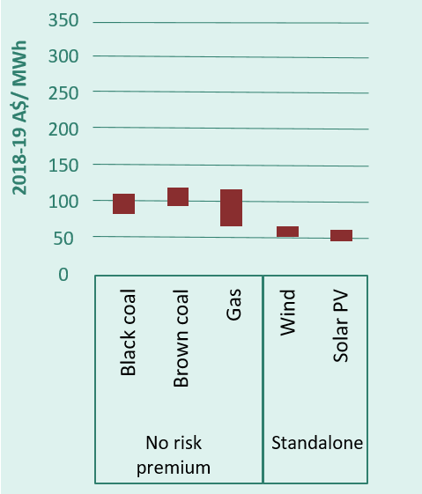
It’s inevitable: Cost
Figure: Costs of Fossil Fuels and Wind and Solar
Renewables are cheapest
Source: AEMO and CSIRO
Notes:
Slide 4: IT’S INEVITABLE: COST
Reason 1. Renewables are now cheaper.
Over the past five years there has been a revolution in the economics of renewable energy.
Wind and solar are now cheaper to build than coal and gas.
Solar is cheaper for a household than grid electricity and these trends will continue.

Slide 5
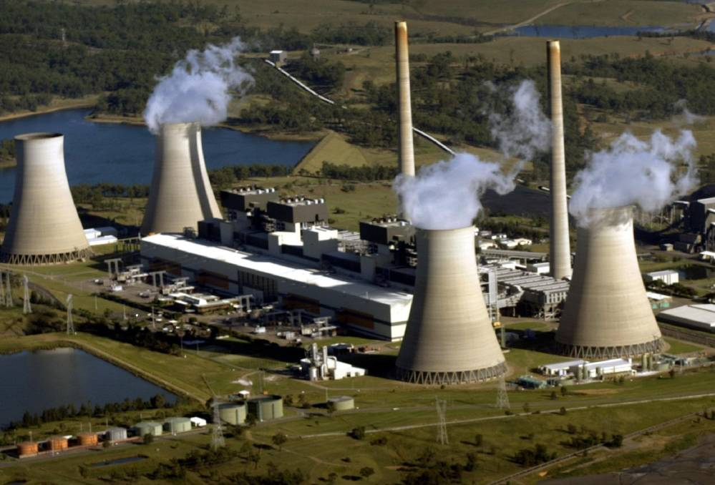
It’s inevitable: Aging Coal
10 coal power plants have shut in the last decade
”Australia’s coal and gas plants broke down every three days in 2018”
The Australia Institute
Notes:
Slide 5: ITS INEVITABLE: AGING COAL
Reason 2: Australia’s coal fleet is old and failing
With the closure of Hazelwood in 2017, Australia’s dirtiest power plant finally shut down. Hazelwood was the latest of 10 old coal plants that have shut down in the last decade. However, there are still 19 more coal-fired power stations chugging away, spewing pollution into the atmosphere.
The plants that are most responsible for cooking the planet are also the worst for our health, emitting more toxic NOx, SOx (nitrogen and sulphur oxides), mercury and particle pollution.
As these old clunkers close they are going to be replaced by the cheapest form of new generation and that will be wind and solar, backed-up by storage.

Slide 6
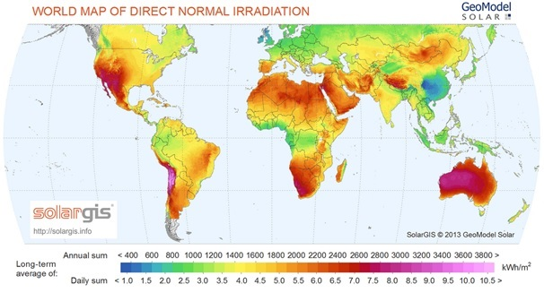
It’s inevitable: Opportunity
Australia has the best resources in the world
Notes:
Slide 6: ITS INEVITABLE: OPPORTUNITY
Reason 3: It's a huge opportunity for Australia
Our country is perfect for solar, wind and wave energy. In fact, we have some of the richest clean renewable energy resources in the world. Indeed compared to places like Germany which are known for being leaders in renewable energy, we have double the amount of sunlight each year in Australia.
We have significant land area and a low population.
We are one of the best-equipped countries in the world to transform our energy system to 100% renewables and help our neighbours go renewables too.

Slide 7
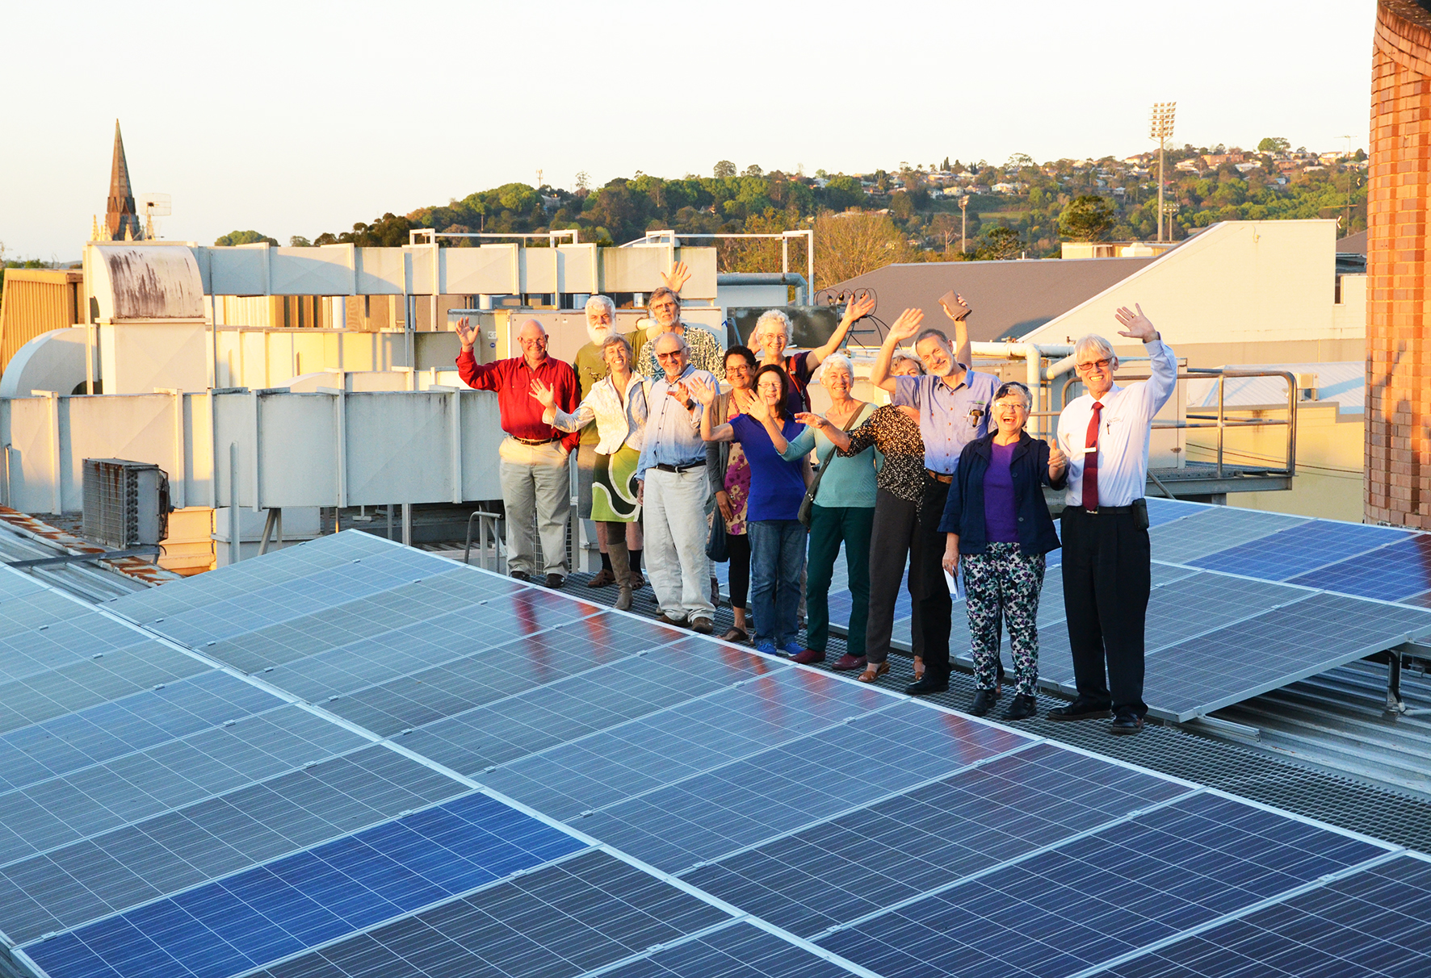
It’s inevitable: Aussies love it
Australia is number one in the world for rooftop solar
Up from less than 100,000 in 2008 to more than 2 million solar rooftops glinting across the country.
3,000 Australian households going solar every single week.
Notes:
Slide 7: IT’S INEVITABLE: AUSTRALIANS LOVE SOLAR
Reason 4: Australians love solar
Poll after poll shows that Australian’s love solar, in fact support for renewables is at 65-90%.
And we’re putting our money where out mouth is. When it comes to rooftop solar, Australia is number one in the world.
There are more than 2 million solar rooftops glinting across the country, up from less than 100,000 in 2008. That means 2 million have been installed in the last decade!
And the numbers are still growing with around 3,000 Australian households going solar every single week.

Slide 8
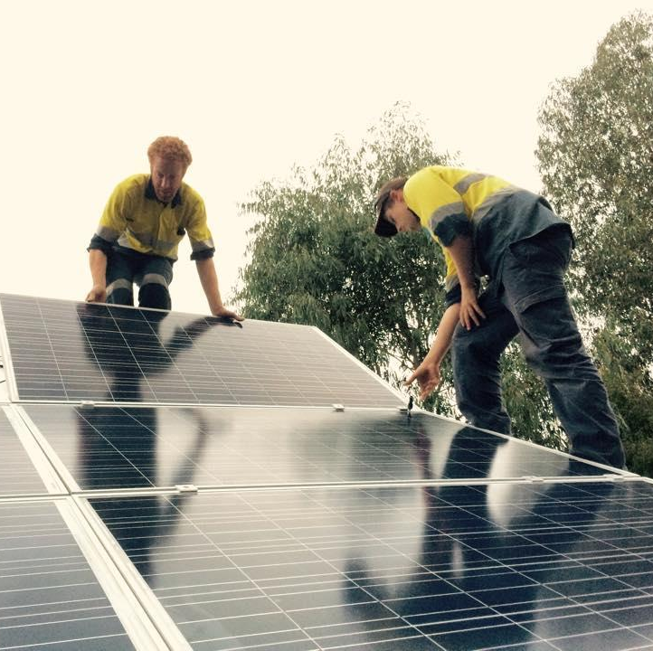


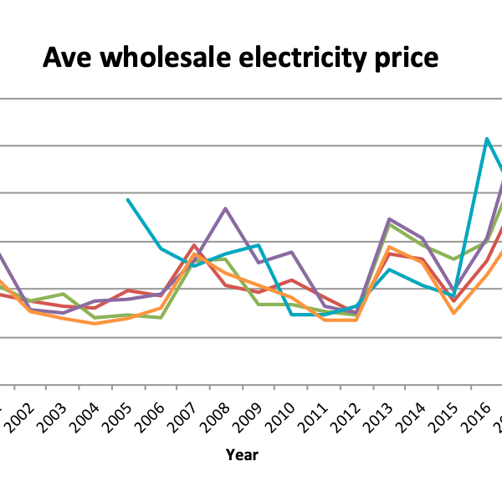
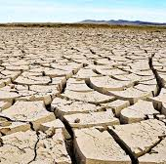
It’s inevitable: Creates a better life…
REGIONAL ECONOMIC DEVELOPMENT & JOBS
CLEANER AIR
A HEALTHY FUTURE FOR OUR CHILDREN
CONTROL ENERGY BILLS
COMBAT CLIMATE CHANGE
Notes:
Slide 8: IT’S INEVITABLE: CREATES A BETTER LIFE
Reason 5: Upgrading Australia to clean energy creates a better life for everyone. It will:
create better jobs and additional regional development
bring cleaner air and so a healthier future for our children
help us control our bills and reduce them,
stop damaging our climate.

Slide 9
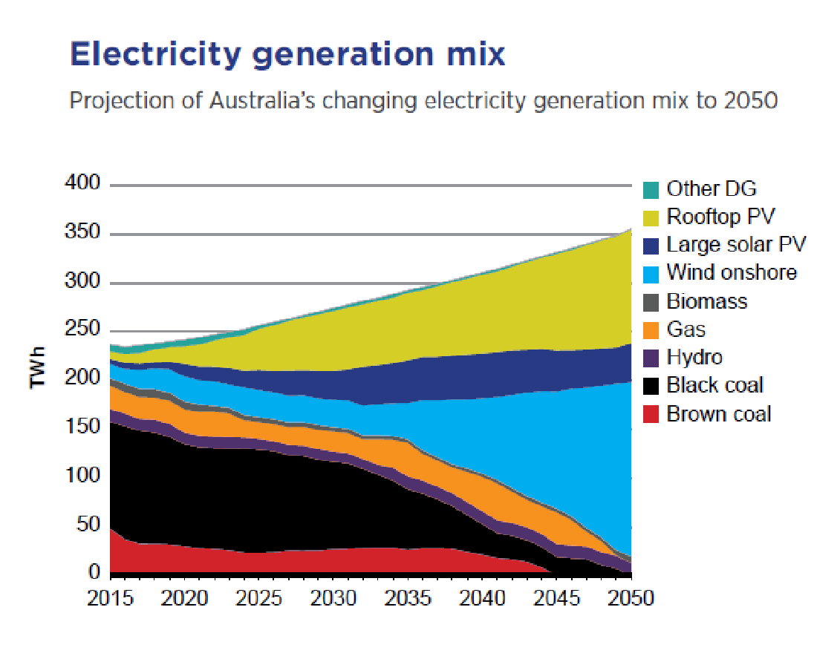
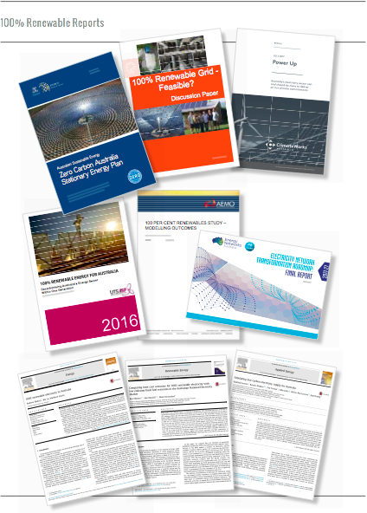
It’s achievable…
Experts agree...
“100% renewables is 100% doable
Experts agree that shifting to an energy system powered by the sun and wind is technically feasible and economically responsible. Nine different expert organisations, from the University of New South Wales to the Australian Energy Market Operator, have all conducted studies that show 100% renewable energy for Australia is 100% doable.
Notes:
Slide 9: ACHIEVABLE
Experts agree that shifting to an energy system powered by the sun and wind is technically feasible.
Modelling from the ISF shows that given the abundance of Australia’s solar, wind and sustainable bioenergy resources, a transition to 100% renewable energy within one generation is both technically feasible and economically responsible.
And they are not alone with their findings. There are at least nine other studies conducted in the last seven years that have analysed how Australia can move from an electricity system based on polluting coal and gas to one powered by the sun, wind and waves.
Indeed, the Australian Energy Market Operator (AEMO) – the very body tasked with making sure we have energy when we need it – found that there are “no fundamental limits to 100% renewables”, and that current standards of system security and reliability will be maintained.
These studies all show different pathways to 100% renewable energy, however what they all agree on is that 100% renewables can be achieved

Slide 10
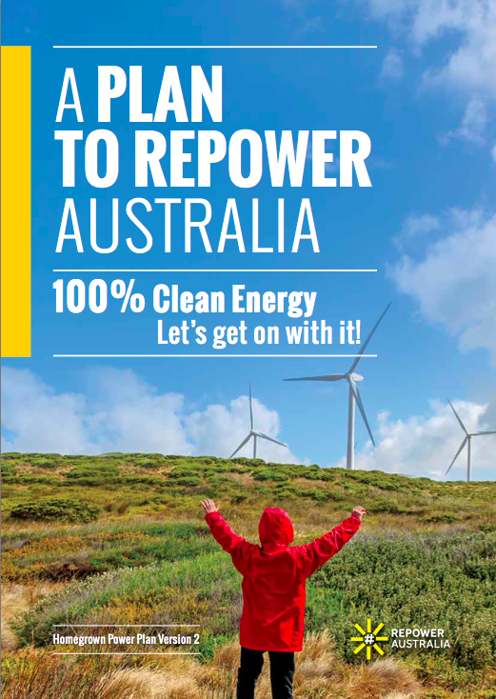
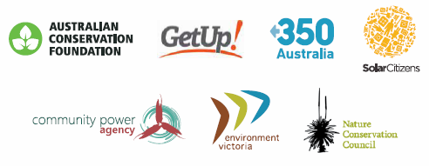
… and we have a plan
REPOWER AUSTRALIA PLAN
Notes:
Slide 10: … AND WE HAVE A PLAN
The good news we have a plan to get there – the Repower Australia Plan. This plan outlines how we can repower the country with 100% clean energy, rewrite the rules of our failing electricity system and replace the polluters holding us back.

Slide 11
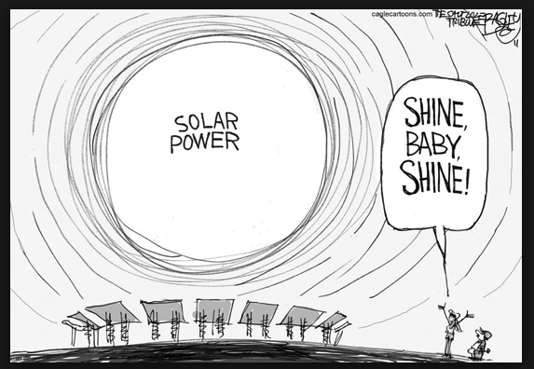
Here’s how 100% renewables will work…
Notes:
Slide 11: HERE’S HOW 100% RENEWABLES WILL WORK
So how will 100% renewables work in practice?

Slide 12
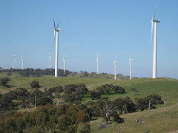
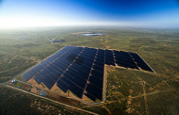
1. Big on low-cost renewables
Notes:
Slide 12: BIG ON LOW-COST RENEWABLES
First we’re going to go big on the least-cost clean energy technology and that is wind and solar. We’re going to see a lot of large-scale wind and solar farms.

Slide 13
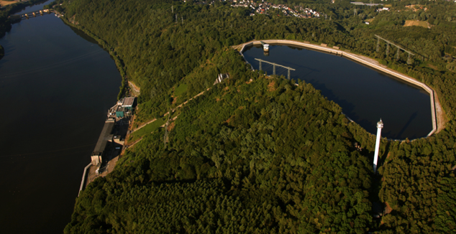
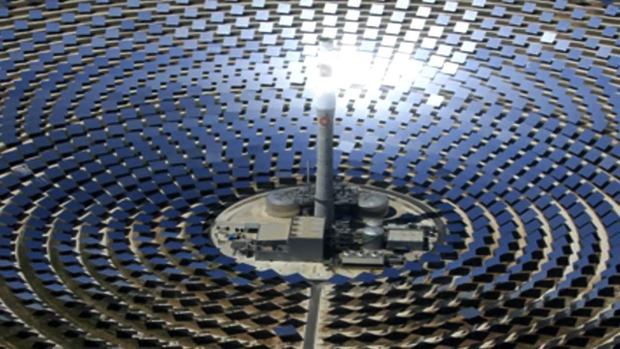
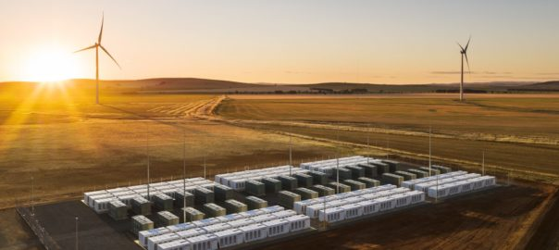
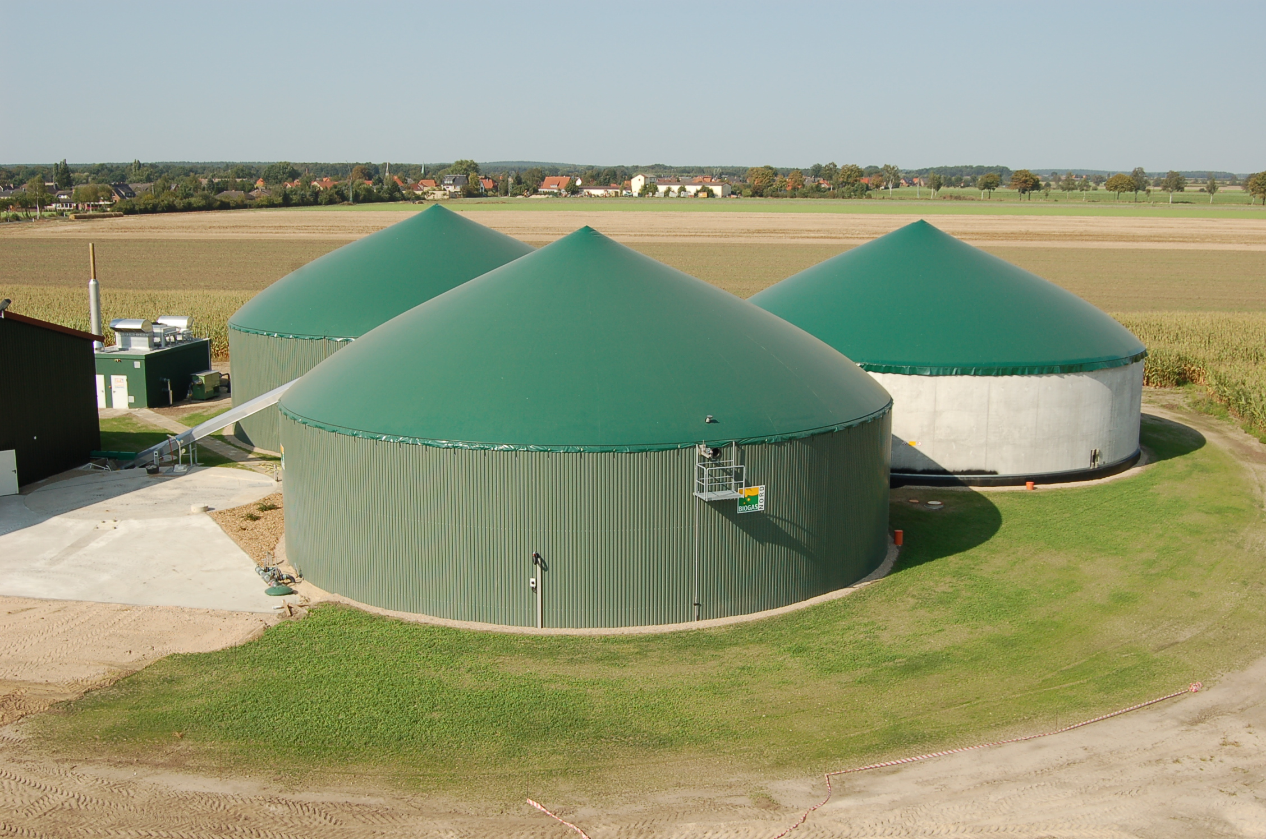
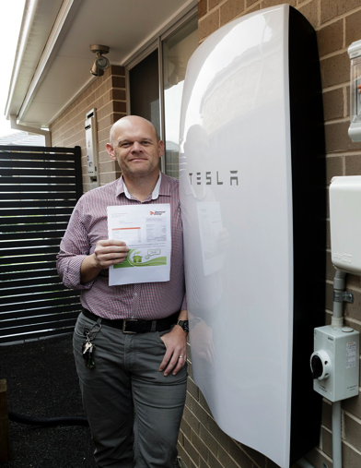
2. Fill the gaps with a diversity of technologies
Pumped hydro
Concentrating Solar Thermal
Batteries
Biogas
Notes:
Slide 13: FILL THE GAPS WITH A DIVERSITY OF TECHNOLOGY
Then we’re going to fill the gaps – overnight and on low-wind days with a diversity of other technologies, like battery storage, pumped hydro, concentrating solar thermal, and sustainable bioenergy.

Slide 14

2. Fill the gaps with a diversity of technologies
Notes:
Slide 14: FILL THE GAPS WITH A DIVERSITY OF TECHNOLOGY
Modelling from both UNSW and energy consultancy ITPower show that to get the least-cost and most reliable mix of generation we need a diversity of technologies, in a diversity of locations, which can run for different durations. For example when the wind is blowing a gale at different times in South Australia and Northern Queensland, so we need wind farms in both places.

Slide 15
2. Fill the gaps with a diversity of technologies
Notes:
Slide 15: FILL THE GAPS WITH A DIVERSITY OF TECHNOLOGY
What this means is complete paradigm shift in how our energy system will work. From a 20th Century system based on baseload coal power plants, that run all the time (because they can’t ramp down) and times of peak energy demand being met by peaking gas plants and hydro power. Moving to a system where the bulk of our electricity needs are met by low-cost variable renewables like wind and solar and the gaps are filled by dispatchable renewable technologies and storage.

Slide 16
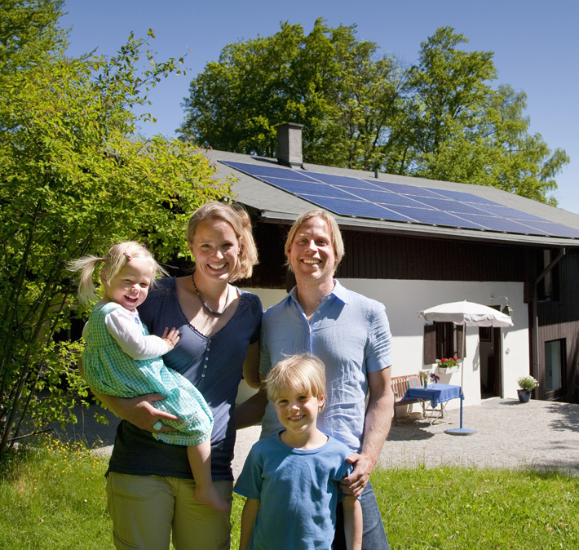
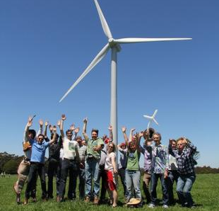
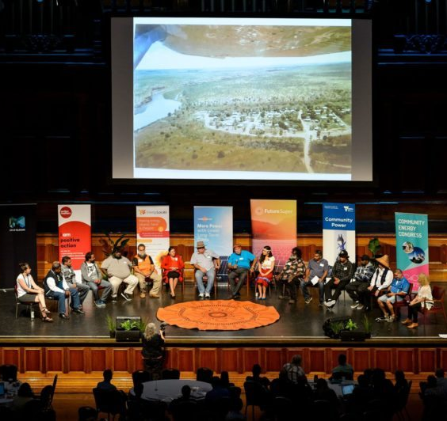
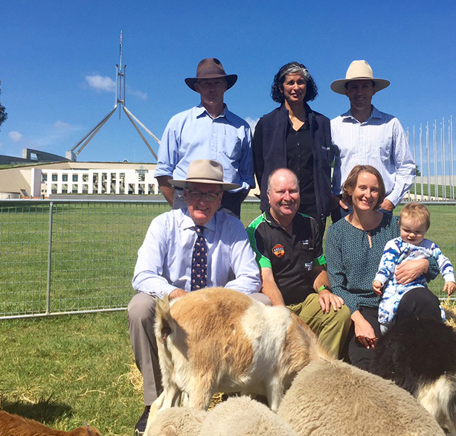
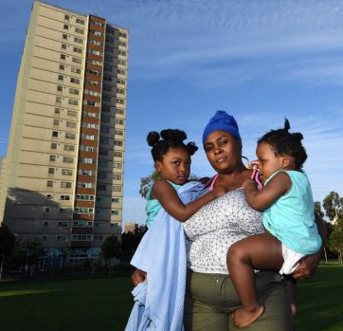
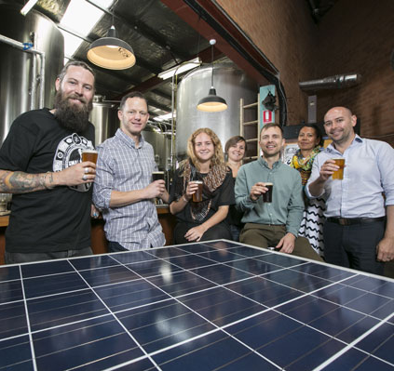
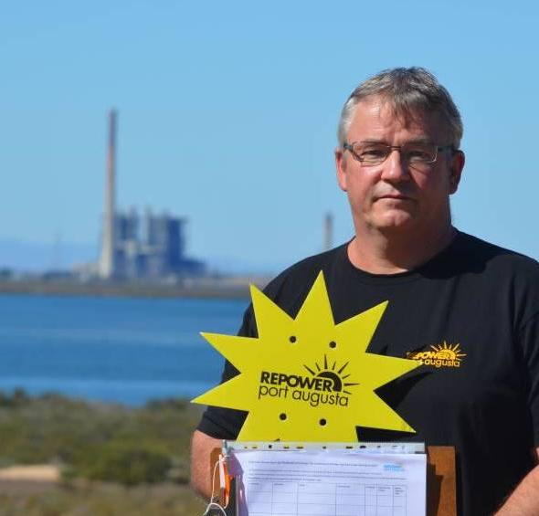
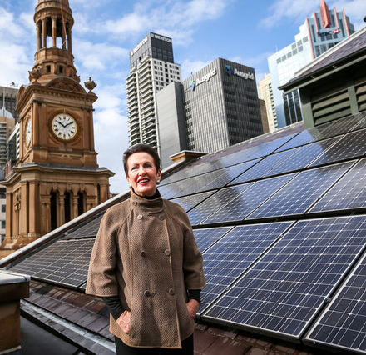
3. Small so everyone can benefit
SOLAR HOUSEHOLDS
COMMUNITY ENERGY GROUPS
ABORIGINAL COMMUNITIES
FARMERS
VULNERABLE
& LOCKED OUT
BUSINESS
FOSSIL FUEL WORKERS
COUNCILS
Notes:
Slide 16: SMALL SO EVERYONE CAN BENEFIT
Actually the new decentralised energy technologies create new opportunities for everyone to participate in our energy system – the small and medium sized systems enable a more distributed application. Just think of the solar household system, hot water system or the smart meters in your home.
With these new opportunities, the times when the motto was a “better power station is always a bigger power station farther away” are gone. In fact, controlling, owning and benefitting from electricity generation is no longer left to a few big corporates anymore. All members of the community can participate and enjoy the many benefits of clean and affordable electricity from renewable energy technologies.
According to CSIRO and Energy Networks Australia at least 30-45% of Australia’s future energy generation will be local and customer-owned, in homes, businesses and communities. In the future all Australians will be able to access and benefit from decentralised generation, energy efficiency and storage.
Apart from the more obvious beneficiaries like solar households, businesses, councils and farmers, the renewable energy revolution creates opportunities for:
Aboriginal and remote communities – solar systems are a no brainer in the outback and can help to significantly reduce their power bills which high as $3000 a quarter;
Vulnerable and locked out energy users -those include renters, people who live in apartments, have unsuitable roofs or cannot afford them. Innovative business models and initiatives like Solar Gardens or the Darebin Solar Savers Program can enable them to participate.
It is also a great opportunity for fossil fuel workers and their communities. The inevitable phase out of dirty coal will bring new challenges but also create the chance to reuse the existing energy infrastructure for renewable energy generation, creating new jobs and bring long-term economic development to these regions

Slide 17

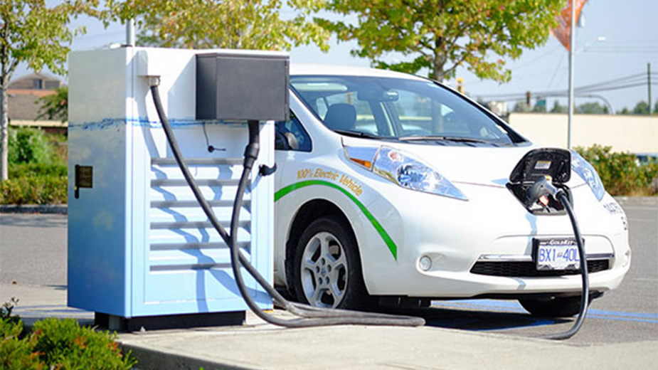
4. Industry and transport go renewable too
“Electricity is a versatile form of energy that can
be used to power any industrial heat process.
By switching to electrical heating we can
halve the energy required to produce many
goods, while reducing costs and increasing
production speed.”
Beyond Zero Emissions
Notes:
Slide 17: INDUSTRY AND TRANSPORT GO TO RENEWABLES TOO
As the world moves to act on climate change, we are going to see cars, buses and trucks move from being powered by petrol and diesel to being powered by electricity. Already in places like Norway, Electric Vehicles make up more than 50% of new car sales.
We will also see our homes switch away from gas for heating and cooking to more efficient electrical appliances. While in industry, a whole range of industrial processes that rely on gas and coal for heat will switch to electric or renewable sources of heat.
Fuel switching from fossil fuels to electricity will increase the demand for more renewable electricity. So our grid will be bigger than before, but we will be much less dependent on importing oil and there will be no need for fracking.

Slide 18
5. Demand is as important as supply
Source: Institute for Sustainable Futures, UTS
Notes:
Slide 18: DEMAND IS AS IMPORTANT AS SUPPLY
The cleanest form of energy is the energy we don’t use. Australian houses and industry are some of the most inefficient in the industrialised world. That means we can go a long way to reduce our energy needs, and create the same result. From better insulated houses, to more efficient industrial processes, energy efficiency will be critical in a clean energy future.
In the past we have focused predominantly on electricity supply, but electricity demand is also important, not only reducing it through energy efficiency, but shifting our energy use. So for example we charge our electric cars or turn on our washing machines or hot water systems when the sun is shining and the wind is blowing. This is called demand response and it is going to be critical in our future energy system.

Slide 19
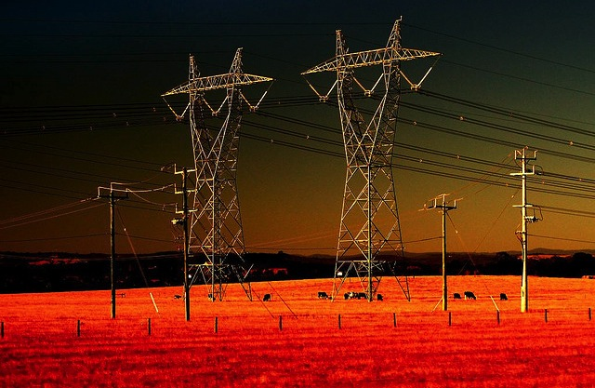
6. Poles and wires only where we need them
The grid is an essential service
Less grid - Edge of grid communities disconnect and become microgrids
More grid – New transmission lines to renewable energy zones
Notes:
Slide 19: POLES AND WIRES ONLY WHERE WE NEED THEM
Over the last decade electricity networks spent $70billion of your money gold plating our electricity grid. This is the single biggest cause of electricity prices rising. The backbone of a 100% renewables system will be a smarter grid. While many people like the idea of going off-grid, the electricity grid is essential, it is part of our welfare system – ensuring everyone can access electricity to heat, cool, cook, wash etc.
The future grid is going to look a little different. In some places there will be less grid – we will disconnect many edge of grid communities from the main grid and they will be serviced by mini-grids, with their own renewables and storage. This will save everyone money.
In some places there will be more poles and wires – we will build new transmission lines to those places where the sun shines the brightest and the wind blows the strongest – these will be Renewable Energy Zones and are the basis for AEMO’s plan for the future of our electricity system.

Slide 20
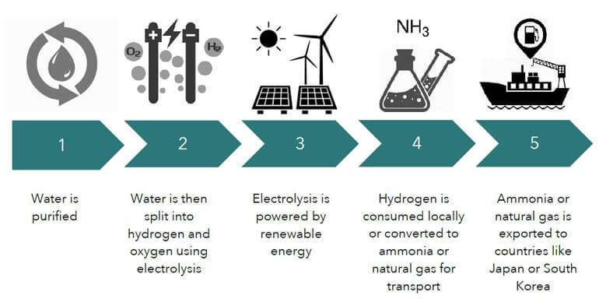
7. We export renewables to the world
Notes:
Slide 20: WE EXPORT RENEWABLES TO THE WORLD
As I already mentioned, Australia has some of the best renewable resources in the world. We can export our renewables as liquid sunshine to our neighbours who have less sun and less land. We do this in the form of Hydrogen and Ammonia. We use excess renewable electricity to split water into Hydrogen and Oxygen. The hydrogen can then be used as a fuel, or turned into ammonia. Ammonia is already one of the top 10 most traded commodities globally and can be exported to places like Japan and South Korea where they will turn it back into hydrogen to power their buses and their industry.

Slide 21
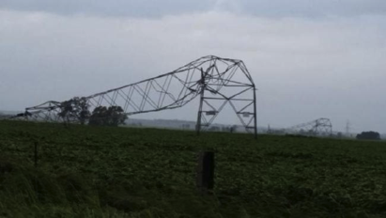
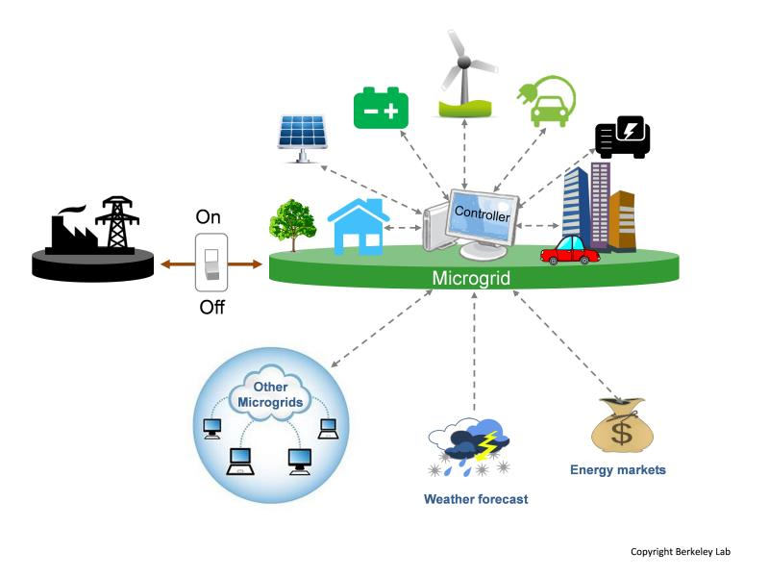
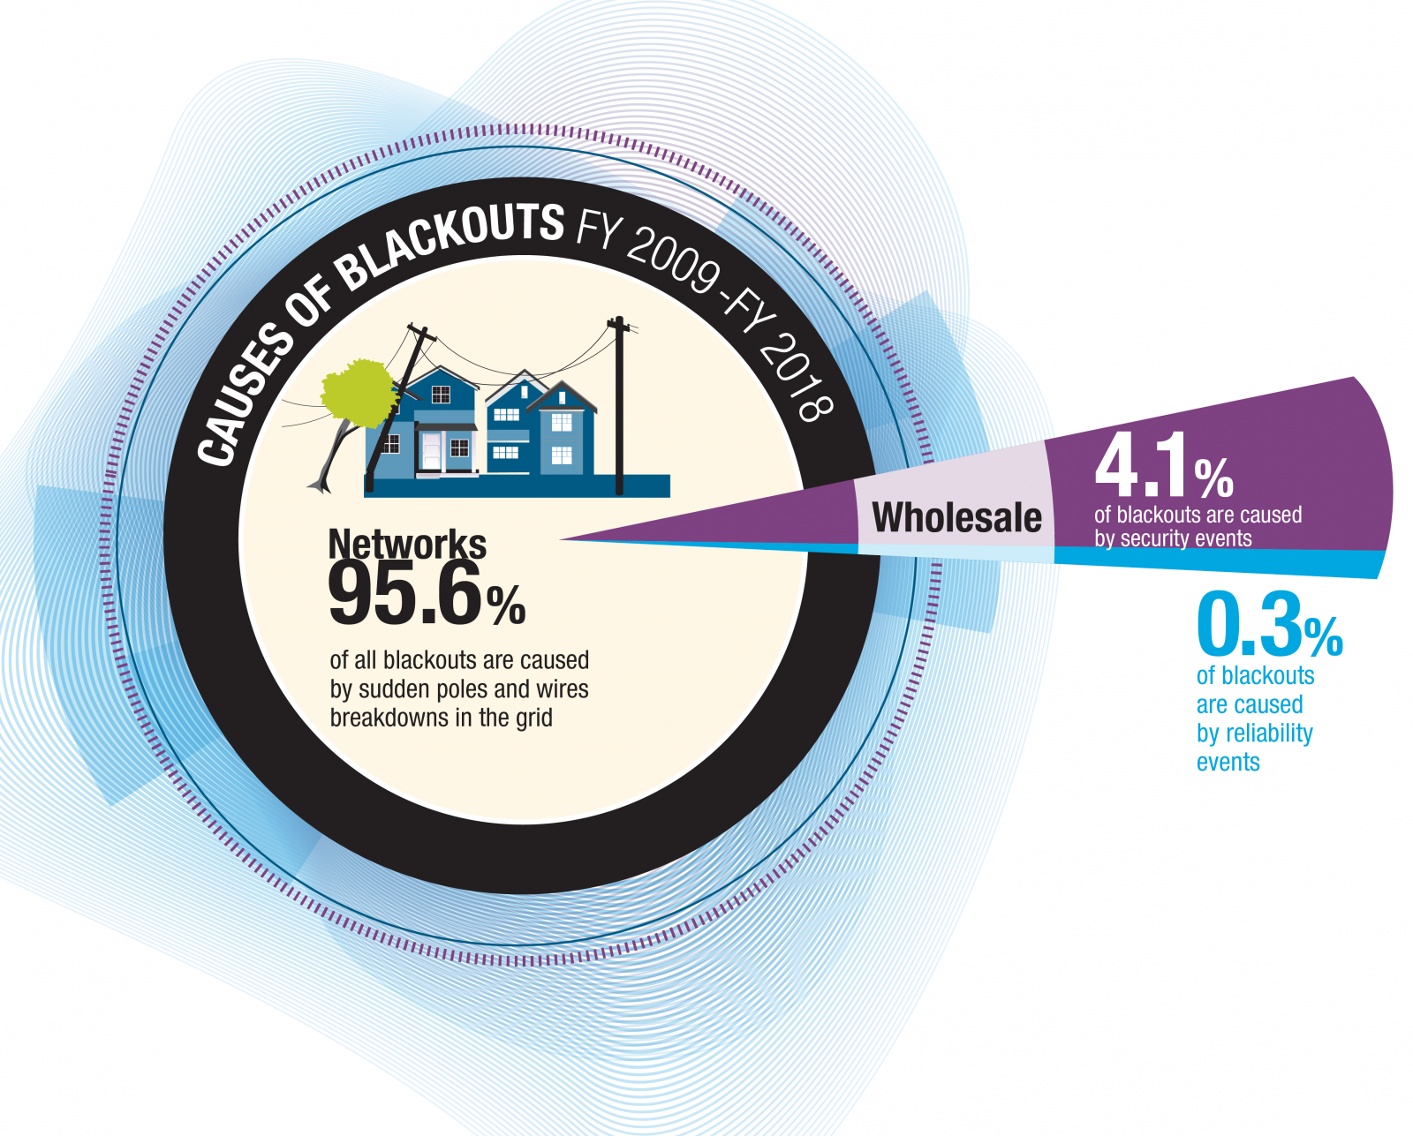
8. More reliable in extreme weather
Notes:
Slide 21: MORE RELIABLE IN EXTREME WEATHER
Contrary to what opponents of clean energy say, the energy system of the future will be more reliable, not less. Over 95% of all blackouts in Australia are caused by our poles and wires failing. A tree falling on them, a line breaking in a big wind storm etc. In the future, if there is a big storm, communities and suburbs across Australia can disconnect from the main grid for a few hours at the time and weather the storm. In those communities there will be enough renewables and storage to power that community for a few hours, while the lines are repaired and the community can be reconnected to the main grid.

Slide 22
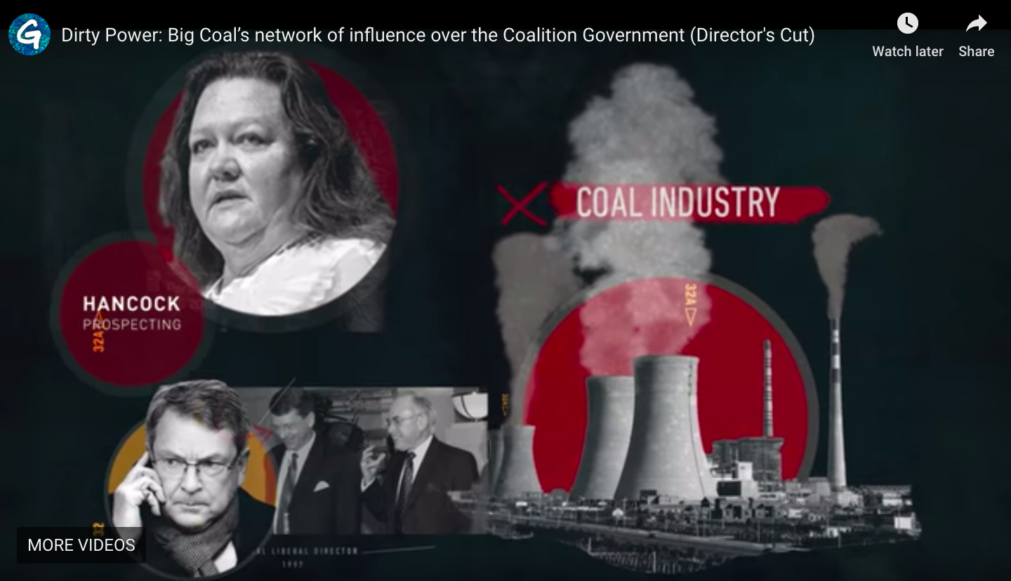
But we’re being held back by coal companies…
Notes:
Slide 22: BUT WE’RE BEING HELD BACK BY COAL COMPANIES
All of this is technically achievable and engineers are working on making the 100% renewable future a reality. Unfortunately, we are being held back. Coal companies have billions of dollars to lose as the world moves away from fossil fuels to renewables. Its no wonder companies like Glencore (the world’s largest coal company) are spending millions running scare campaigns about renewables and coal barons like Trevor St Baker are lobbying for new coal fired power stations and Clive Palmer spent $60million dollars on the last election to help advance his new coal mine in Queensland.

Slide 23
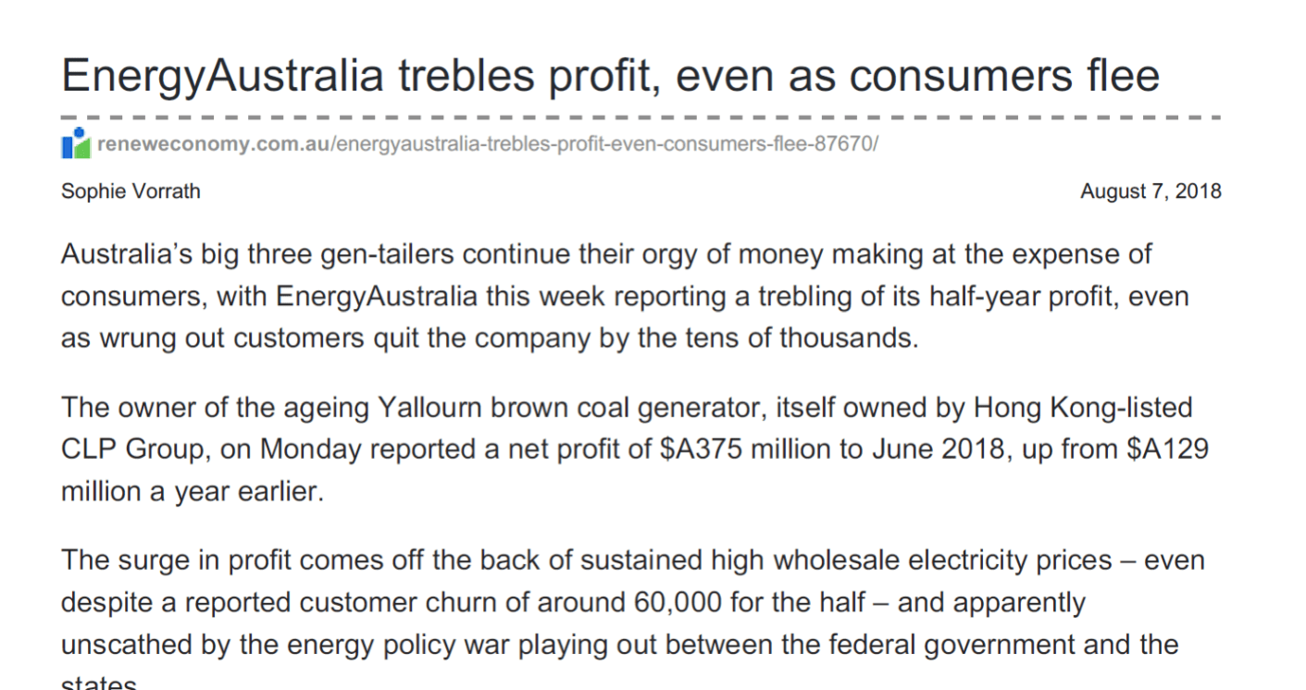
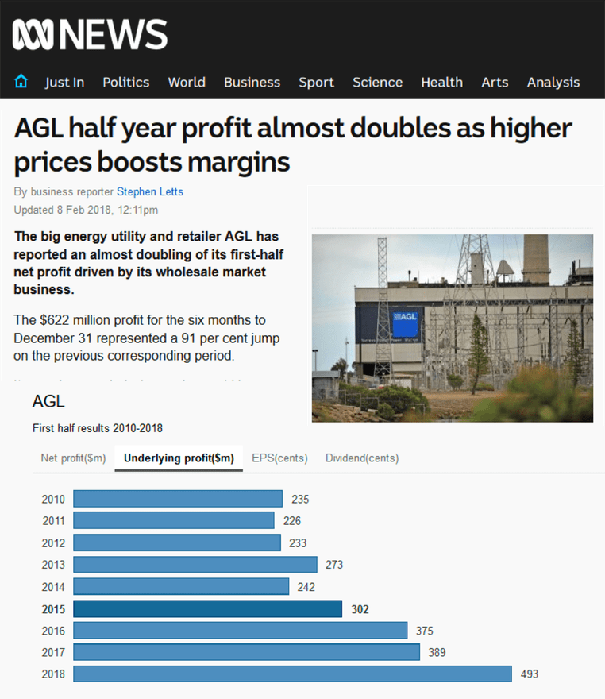
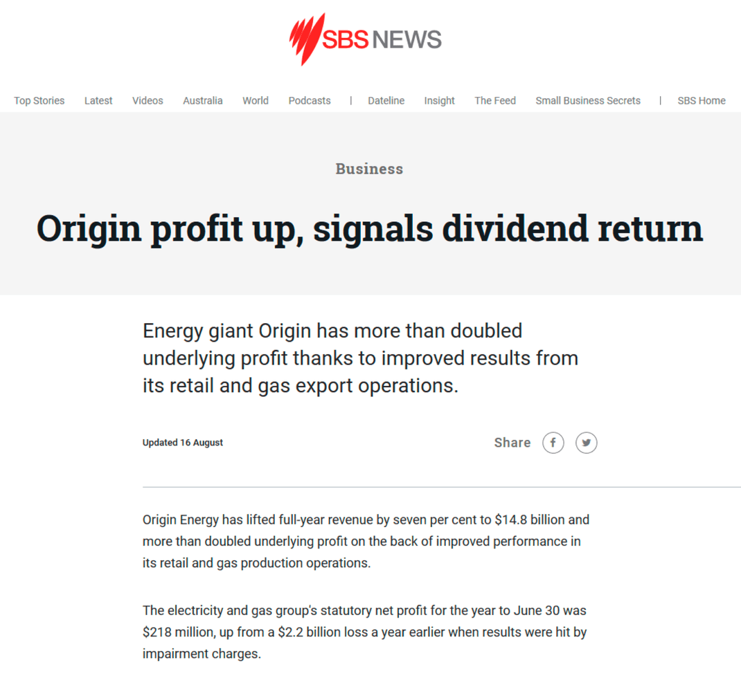
… and ripped off by energy companies
EnergyAustralia recently reported a half-year profit of $375m to June 2018 – up from $129m a year earlier
– closely followed by AGL, with a near-tripling of its own net profit for 2017-18.
www.abc.net.au/news/2018-02-08/agl-half-year-profit/9407330
Notes:
Slide 23: AND A GREEDY FEW ENERGY COMPANIES ARE RIPPING US OFF
And it’s not just the coal companies. The big three energy companies – AGL, Origin and Energy Australia – are also working to delay the transition to clean energy to increase their own profit margins. Indeed, they have a bad record in cleaning up the sector.
After Hazelwood closed, analysis by Victoria University found that the Big 3 pushed up the price of their coal power, gouging customers to the tune of $3billion.
It is unacceptable that these companies are hoarding more profits while making people sick and putting our whole world at risk.

Slide 24
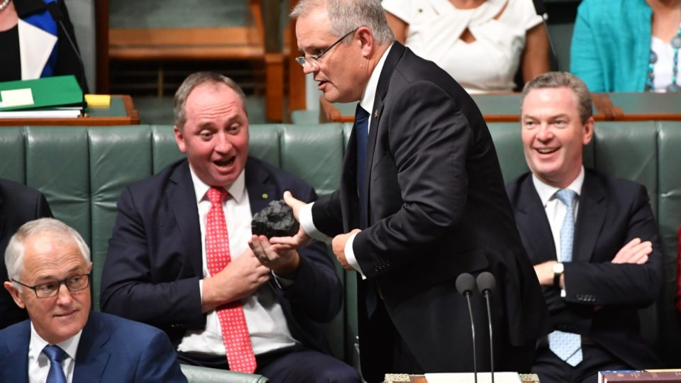
...and the politicians in their pockets
Notes:
Slide 24: AND POLITICIANS LETTING US DOWN
Unfortunately our politicians are also burying their heads in the sand. They letting us down by continuing to back coal and refusing to lead on climate change. Indeed, many Australian politicians are out of step with what is happening internationally.
In fact, Australia is the only developed country that allows climate change funding to be used to upgrade coal-fired power plants. Early March the Morrison government announced Vales Point coal-fired power station could register with the government’s emissions reduction fund and claims this to be a “climate solutions” policy. (https://www.theguardian.com/environment/2019/mar/01/out-on-its-own-australia-the-only-country-to-use-climate-funding-to-upgrade-coal-fired-plants)

Slide 25
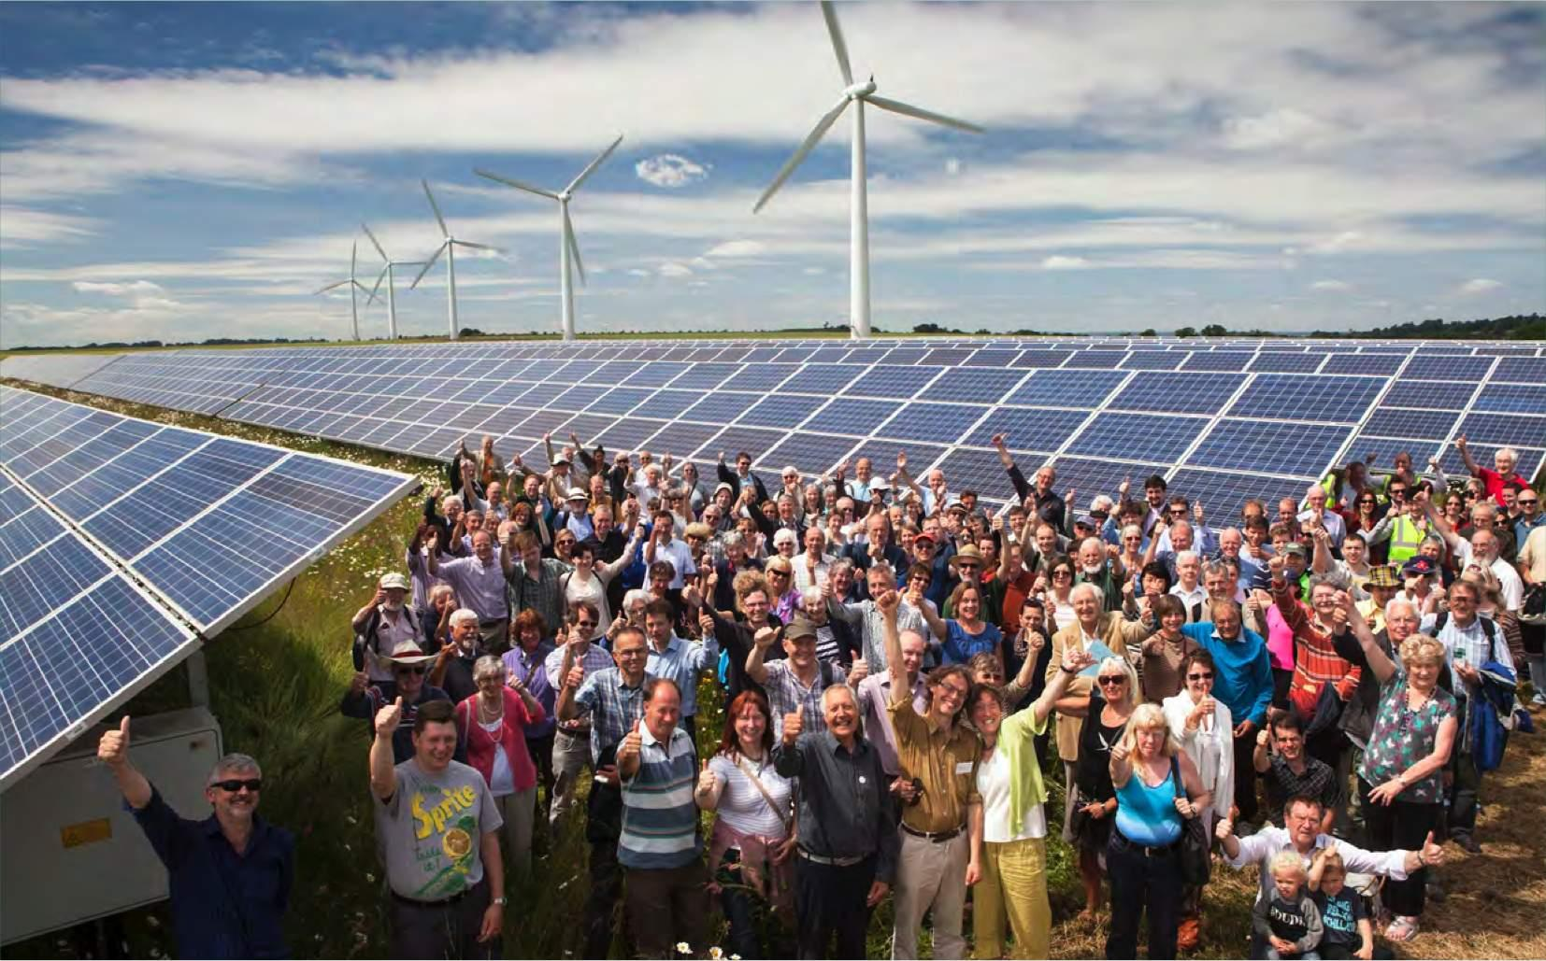
So we must take back control
We have to fight for solutions and take back control of our energy
and our future!
Notes:
Slide 25: WE MUST TAKE BACK CONTROL
So what do we do?
We have to fight for solutions and take back control of our energy and our future!
The good news is that that’s just what many people are doing. I want to share with you just a few stories of Australians taking back control and driving a faster and fairer transition to clean energy…

Slide 26

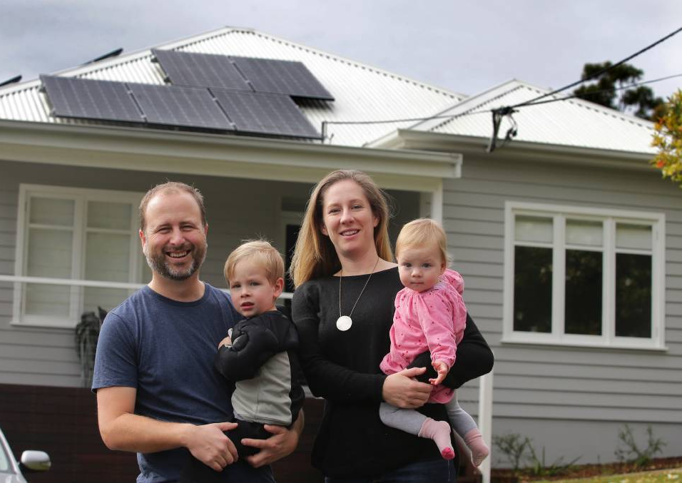
Sunny Shire
Jonathan Prendergast founded Sunny Shire in southern Sydney. Sunny Shire has run several rounds of bulk buys to help Shire residents get solar, batteries and use energy more efficiently.
Notes:
Slide 26: SUNNY SHIRE
Jonathan Prendergast lives in the Sutherland Shire or “the Shire” where people such as our Prime Minister Scott Morison and Craig Kelly MP hail from. The Shire isn’t a hotbed of solar, so Jonathan decided to change that. He got a few friends together and founded Sunny Shire. What Sunny Shire has done, is make it easier for local households to get solar and batteries. They have run a bulk-buy program with discounted prices, selecting trustworthy local solar companies and equipment and ultimately seeing through the installation process.

Slide 27
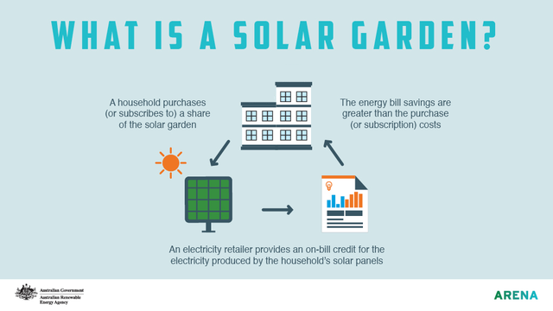
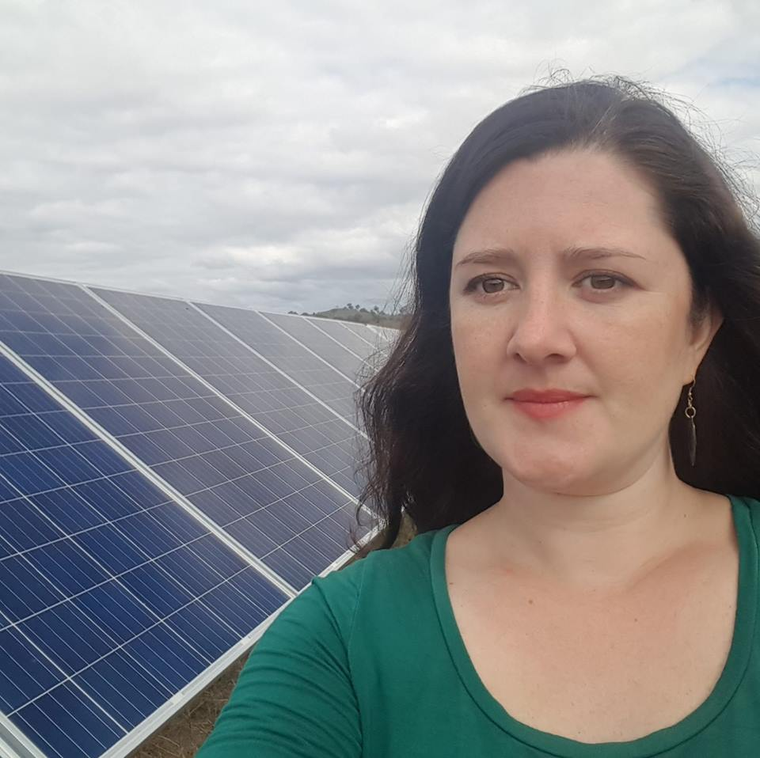
Solar Gardens
Nicky Ison is a renter, who is working with her team at Community Power Agency to make solar gardens a reality for renters and other locked-out households in Australia.
Notes:
Slide 27: SOLAR GARDENS
This is Nicky Ison, she rents an apartment and despite asking nicely, her landlord won’t install solar. That’s why she and her organisation Community Power Agency are working together to create a new way of doing solar, for those who don’t own a sunny roof. It’s called a solar garden.
A solar garden works by installing a centralised solar power system off-site on a warehouse roof or in a paddock at the edge of town. Renters like Nicky then have the opportunity to lease or buy a share of panels in the system, with the electricity their panels generate credited on their electricity bill. Though the panels are located somewhere else, Nicky gets a similar outcome as having solar on her own roof.

Slide 28
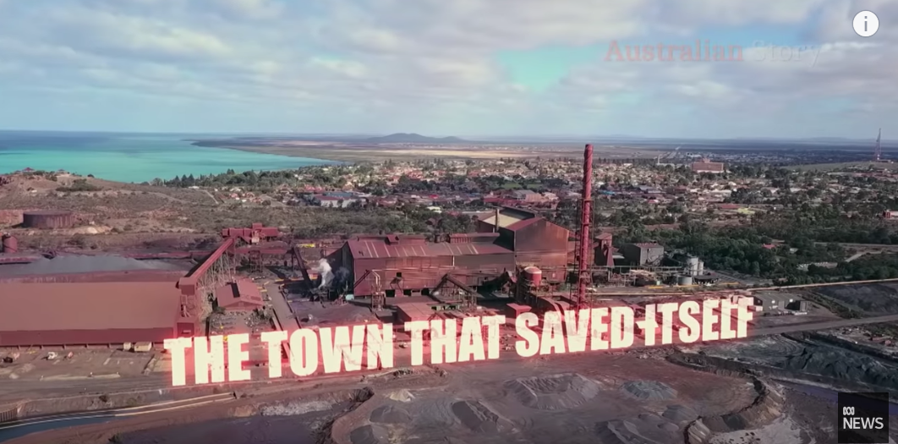
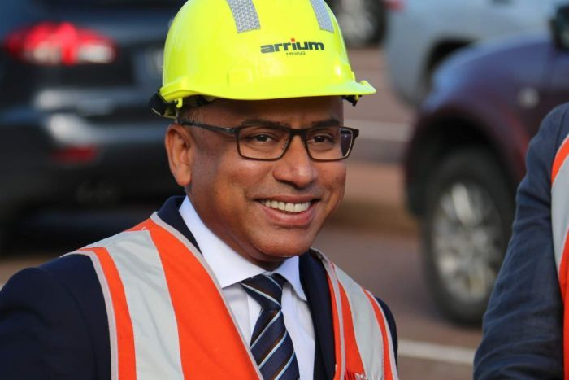
Whyalla Steelworks
Imminent closure of Whyalla Liberty OneSteel steelworks brought the town of Whyalla in dire straights
Solution: Building $1 billion solar farm near Whyalla in 2019 – 280-MW Cultana Solar
Benefit: Employing 350 workers during construction + greater energy security to local steel business.
“Renewables are the "ultimate liberator" to energy-intensive industries like the Whyalla steelworks.”
Sanjeev Gupta
Notes:
Slide 28: WHYALLA STEELWORKS
Let’s check out a great example how a large energy user a steel business in South Australia actually moved to renewables and helped save a town!
In a nutshell:
Whyalla is a regional town of about 23,000 people, about 380 kilometres north of Adelaide.
In 2016 the South Australian town was on the verge of collapse. Crippled by $4 billion worth of debt, the steelworks' owner, Arrium, had gone into voluntary administration. The jobs of 3,000 employees hung in the balance.
Billionaire Sanjeev Gupta, turned around the town's fortunes by buying the steel business and committing to power it by renewable energy.
The company announced it would start building a $1 billion solar farm near Whyalla in 2019
The project will employ 350 people in the construction phase and providing greater energy security to the Whyalla Liberty OneSteel steelworks.
Sanjeev Gupta said the investment by his company, SIMEC ZEN Energy, formed part of his firm belief there was a great future for energy-intensive industries through a transition to more renewable energy.
The renewable energy projects in the Spencer Gulf region would substantially reduce the cost of electricity for the steelworks but would also provide competitive sources of power for other industrial and commercial users by feeding energy back into the electricity grid.
https://www.abc.net.au/news/2018-08-15/gupta-launches-1-billion-renewables-program-in-whyalla/10122036
https://reneweconomy.com.au/gupta-doubles-down-on-green-industrial-plans-for-whyalla-powered-by-cheap-renewables-24759/
https://www.abc.net.au/news/2018-09-24/whyalla-steelworks-how-a-town-saved-itself/9984998

Slide 29
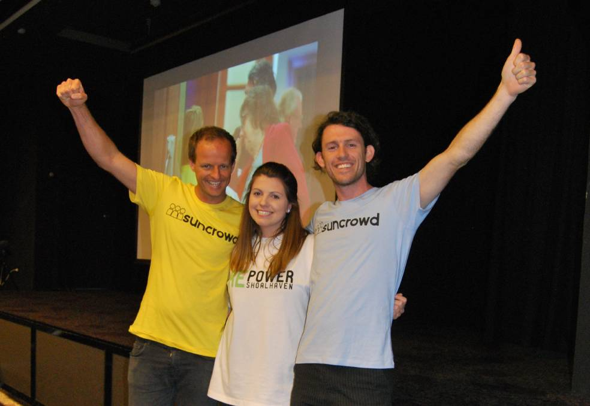

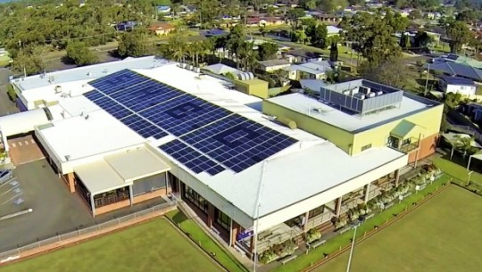
Repower Shoalhaven
Chris Cooper founded Repower Shoalhaven, which develops community solar projects for local Shoalhaven businesses and individuals to participate in.
Notes:
Slide 29: REPOWER SHOALHAVEN
Chris Cooper is a community entrepreneur who grew up in Nowra on the south coast of NSW. About 6years ago he founded Repower Shoalhaven. Repower Shoalhaven supports local businesses to go to solar and allows local community members to invest in these projects.
Probably the best known example of this model is Repower One – a 100kW solar farm installed on the roof of the Shoalhaven Heads Bowling Club. The Bowling Club purchases the solar electricity at a cheaper rate, the community energy group owns the solar panels and employs two young people and the community investors get a better than bank return on their investment – a win, win, win.
Of course they are not the only example, there are many more communities that have initiated their own community power projects.

Slide 30
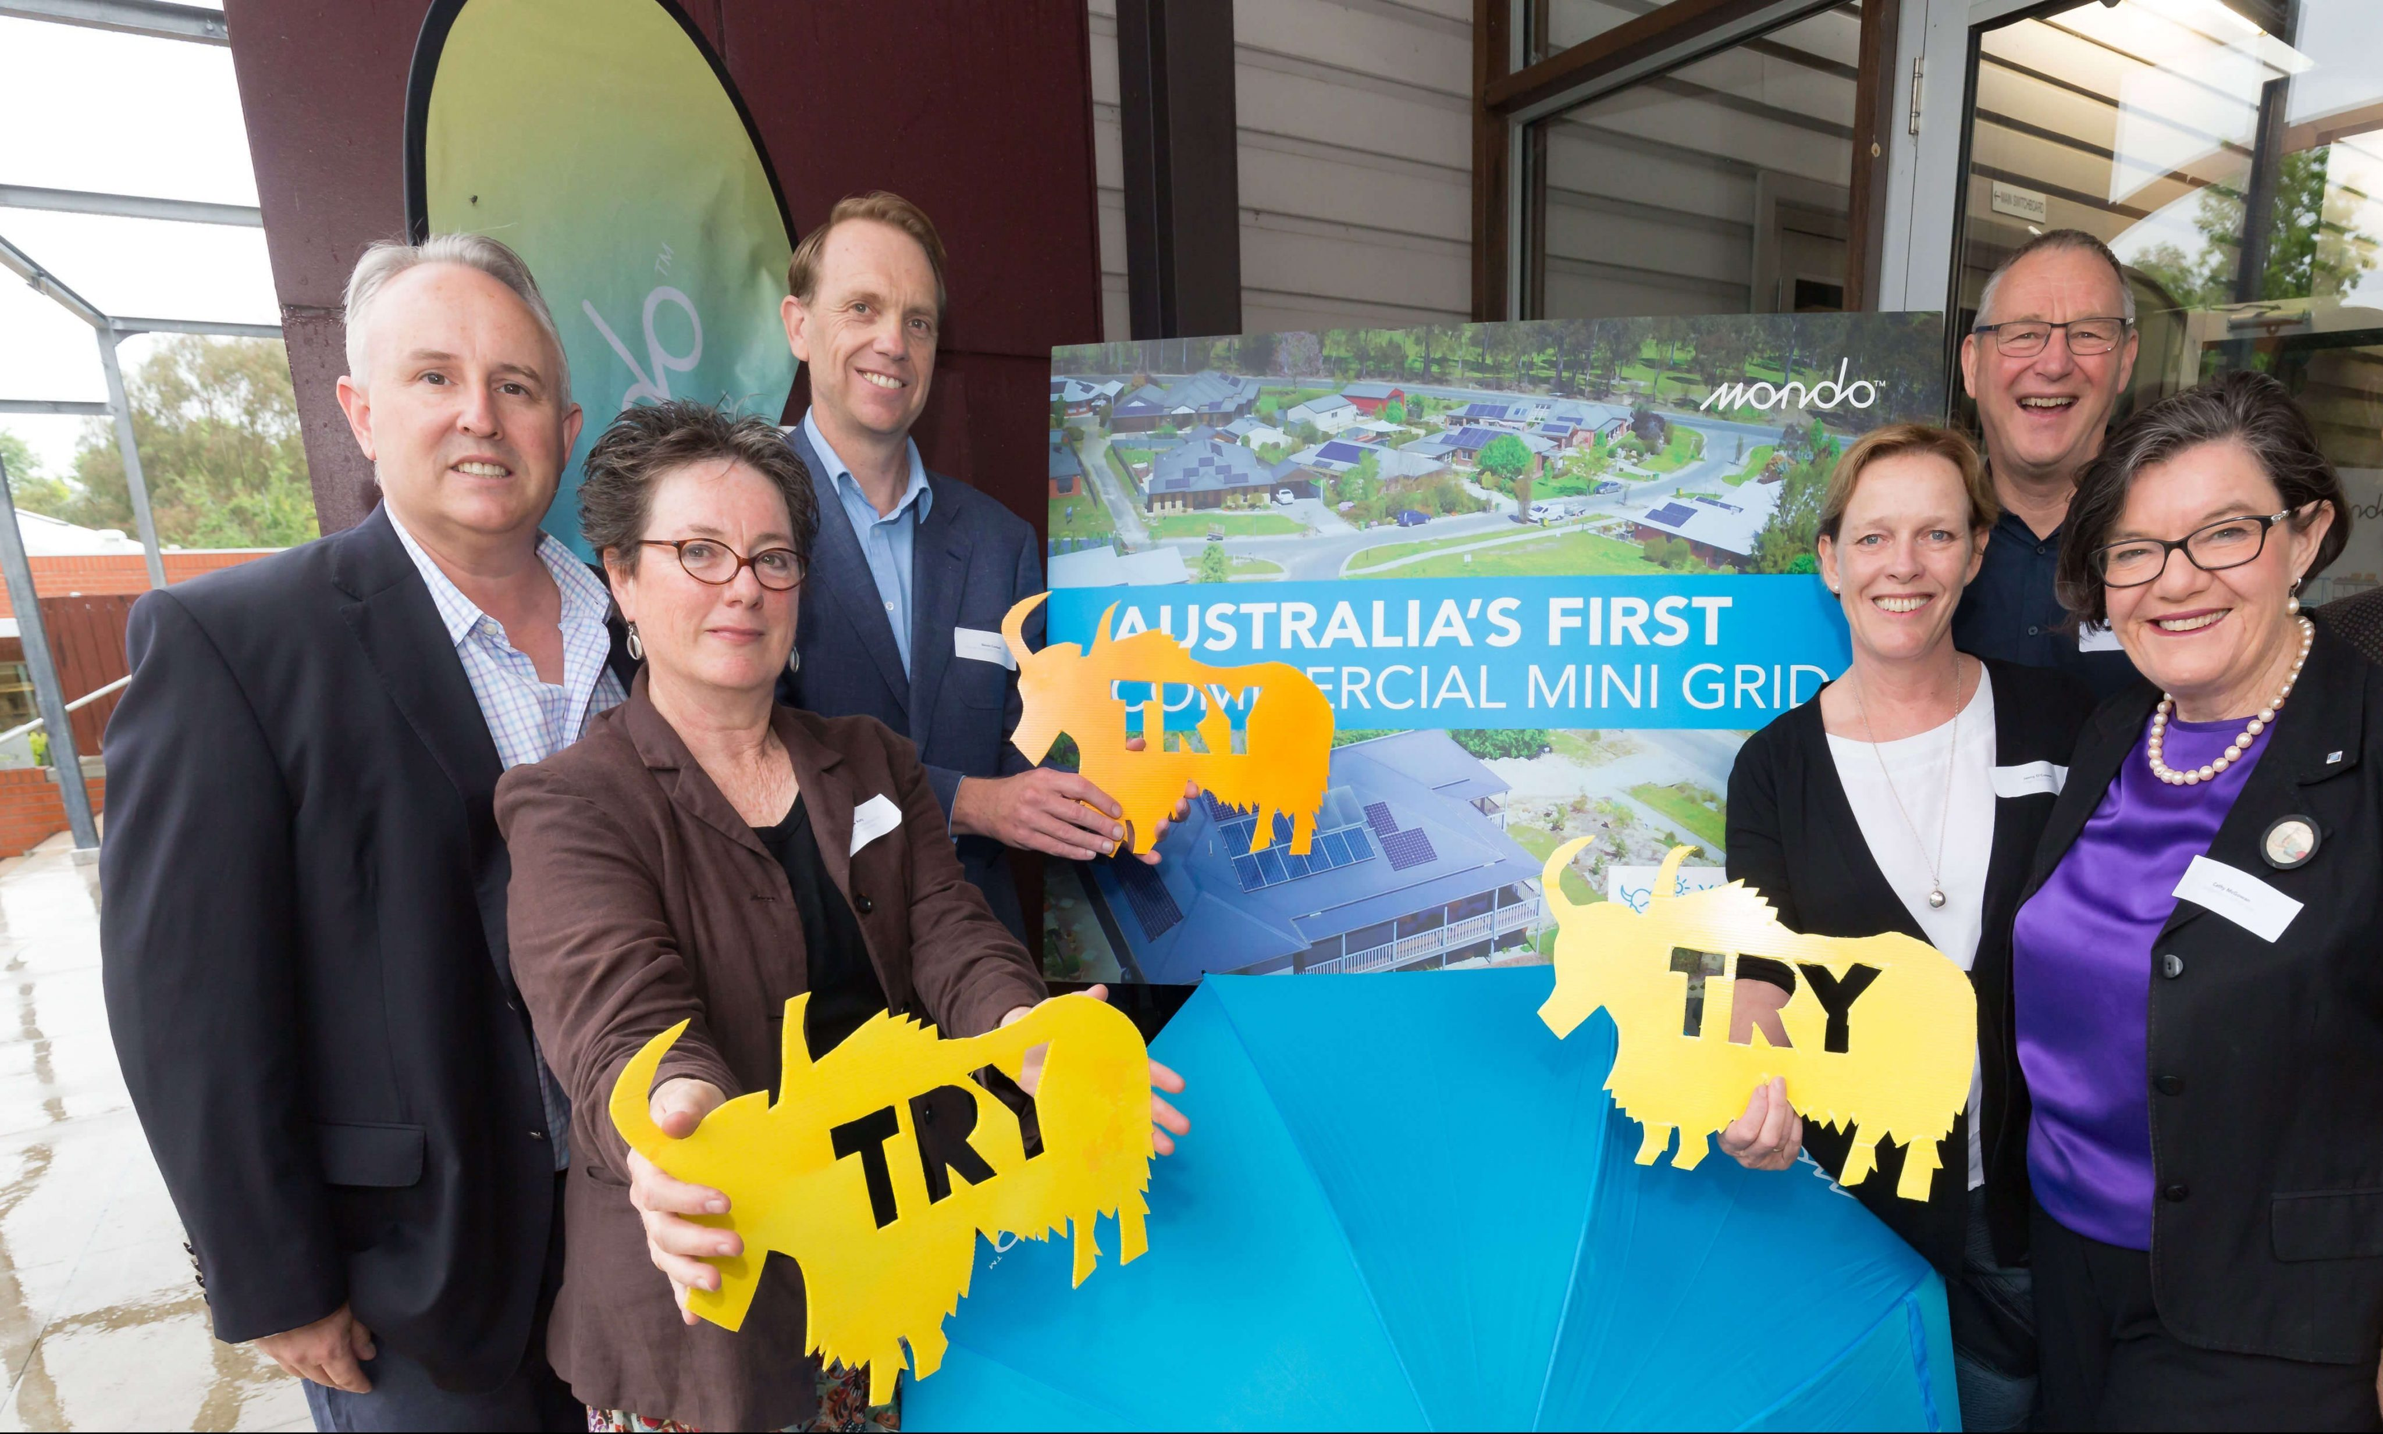


Totally
Renewable Yackandandah
Matt-Charles Jones founded Totally Renewable Yackandandah which has developed two community micro-grids in partnership with Mondo Power and is looking to allow peer-to-peer energy trading as part of taking their community to 100% renewables by 2022.
Notes:
Slide 30: TOTALLY RENEWABLE YACKANDANDAH
Totally Renewable Yackandandah is another great example. A few years ago Matt Charles Jones organised a forum of local people where they together set the goal of taking their town to 100% renewables by 2022. Since then they have pioneered a microgrid approach for their town, in partnership with an organisation called Mondo Power. They have supported households to install solar and batteries and a bit of kit called an Ubi. This smart kit allows different solar and battery systems to talk to each other. They are currently setting up a community-owned retailer – Indigo Power, which will then mean this Ubi can be used to allow households to share and trade electricity with one another.

Slide 31


Stucco
Housing
Cooperative
Bjorn Sturmberg and Sarah King created a embedded solar and battery microgrid for their Sydney 8-unit housing cooperative. They get ~80% of their electricity from the microgrid and save $35/month.
Notes:
Slide 31: STUCCO HOUSING COOPERATIVE
Bjorn Sturmberg and Sarah King lived in a housing cooperative in Sydney while they studied at Sydney University. They and some of their friends got excited about the idea of powering their apartment complex with solar and batteries. So they applied for a grant from the City of Sydney. With some legal and technical help and a lot of volunteer hours they created an embedded solar and battery microgrid for their unit housing cooperative. Now the tenants of Stucco get ~80% of their electricity from the microgrid and save $35/month on their electricity bills.

Slide 32

Hepburn
Wind
Hepburn Wind is the owner and operator of Australia’s first community-owned wind farm in Daylesford, Victoria
The energy cooperative hosts two turbines called Gale & Gusto, which produce 4.1 MW – enough clean energy for over 2000 homes.
2000 Members, 51% local people
$15k per turbine per year re-invested into a Community Sustainability Fund
Notes:
Slide 32: ENERGY CO-OP HEPBURN WIND
Another well-known example of community energy in Australia is the flagship project Hepburn Wind.
Hepburn Wind is Australia’s first community-owned wind farm, at Leonards Hill, about 100km north-west of Melbourne, just south of Daylesford Victoria. The 4.1 MW wind farm hosts two turbines called Gale and Gusto, so named in a competition at the local primary school. Gusto and Gale produce enough clean energy for over 2000 homes. Hepburn wind is owned by a cooperative of 2000 members, of which 51% are local.

Slide 33

… across the country
105 community energy groups
147 community energy projects
Notes:
Slide 33: COMMUNITIES DEVELOPING THEIR OWN PLANS ACROSS THE COUNTRY
These are just a few examples of the everyday Australians leading the transition to clean, renewable energy.
We mentioned the 2 Million households but even more excitingly, people powered clean energy isn’t stopping with rooftop solar and consumer choices.
There are now more than 105 community energy groups that have sprung up across the nation, developing innovative local clean energy projects.
And a whopping 147 operating community energy projects up from just a handful in 2010
Thousands of Australians are willing and able to get local renewable energy projects going in their communities, particularly in regional and rural areas.

Slide 34

Lets get on with it!
to make the clean energy transition faster and fairer for all
Notes:
Slide 34: LET’S GET ON WITH IT
Clean energy is a huge opportunity for Australia and Australians. But more than that, we must do this if we want to do our fair share of tackling one of the biggest challenges we face today – climate change.
We have the technology, skills and solutions to do this.
So let’s get on with it.

Slide 35
What you can do…
Notes:
Slide 35: HOW CAN YOU GET INVOLVED?
We will brainstorm this together…

Slide 36

THANK YOU
Notes:
Slide 36: THANK YOU

